Slide 1


ASFIP Foundation is a non-profit organization (501c 3), located in Atlanta. The Foundation was established as community outreach effort from the CFA Society Atlanta (an Atlanta CFA organization since 1960 with over 1600 members). ASFIP Foundation promotes financial literacy in the Atlanta community where CFA members work.

Slide 2

Invest in You
Manage Risks
Financial
Well-being
Live with Less
Invest for You
Our logo is made up of four “corner” pieces (or principles) which we like to think of as pieces of a frame
Our foundation tries to bring these principles to the community for improved financial well-being
We are helping individuals establish themselves with a plan for long term financial well-being

Slide 3

Invest in You
  The effort you put into consistently investing in yourself plays a large role in determining the quality of your life now and in the future.
Areas of Investment
  Education – Human capital has historically shown good return when skills or education are achieved
  Health – Improved lifestyle results in numerous benefits beyond the obvious physical advantages
  Contentment – The state of being satisfied with what you have will meaningfully impact quality of life, regardless of financial status

Slide 4
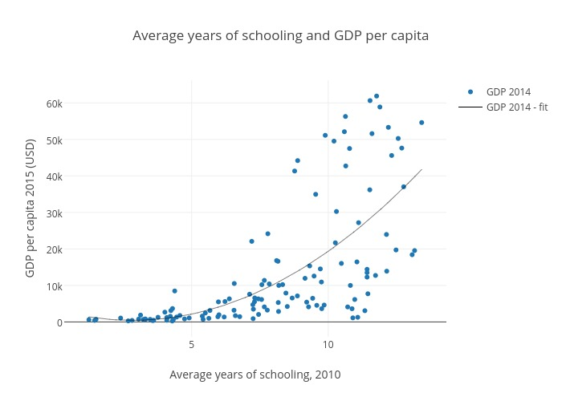
Invest in You
  Human capital was a term which came out of the Nobel Prize winning research of Gary Becker in 1964.
What does it mean for you?
  Capital is something an individual gets and can apply throughout their life
  Many industries (i.e. investment/software) the main capital goes up and down the elevators every day and they could go across the street if not cared for
  US – 30% college graduates versus ex US = 6%, continual learning will lead to higher incomes and cause greater prosperity so, “the more you learn, the more you earn!”.

Slide 5
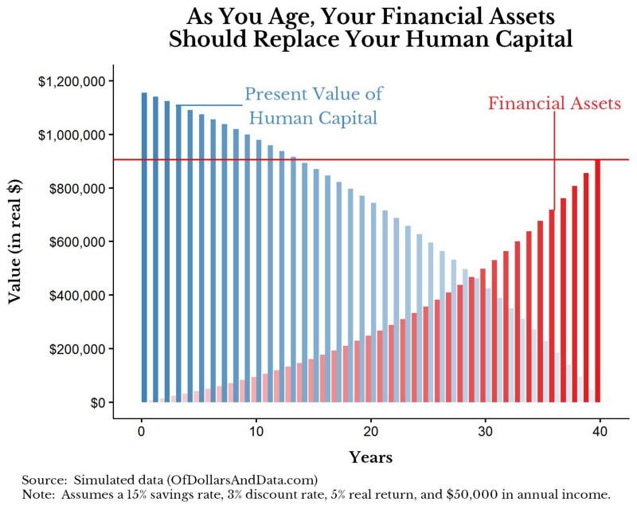
Invest in You
Most of your financial value is already contained within yourself, waiting to be unlocked over time.

Slide 6
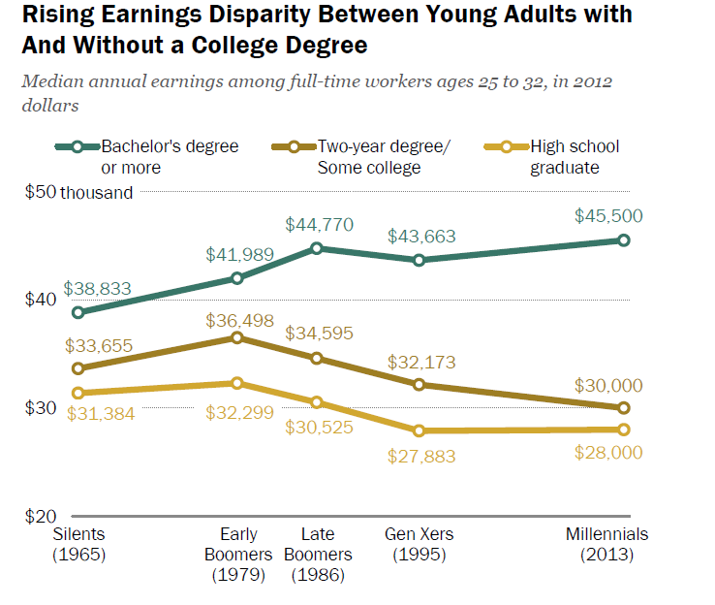
Invest in You
  Education
  Earnings disparity between education levels continues to widen

Slide 7


Highlight the benefits to college completion and to lifelong learning
Play :47 to 1:30

Slide 8
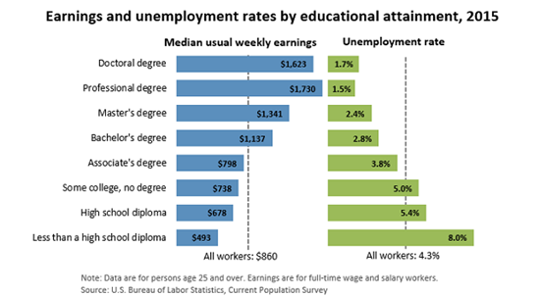
Invest in You
As educational attainment increases, so does the median weekly earnings
The stability of the earnings also improves as the unemployment rate goes down significantly
Attainment of Bachelor’s degree seems to be where above average results are achieved

Slide 9
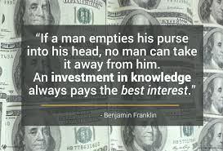
Invest in You
While much of the research focuses on the benefits of formal, post-secondary education, there is a variety of ways to increase one’s level of education
  Advanced degrees
  Relevant certifications
  Workshops/Conferences
  Books, articles, publications, blogs, news
Notes:
Develop your skills, advance your education
Advanced degrees, relevant certifications, workshops, conferences, webinars, books, articles, white papers, publications, blogs, news
Learning a new skill can help develop passions and interests in life

Slide 10
Invest in You – Health
Benefits of investing in personal Health encompass various aspects of well-being including physical, psychological as well as financial
Body is like a well-oiled machine. (Lifehack)
Give it high quality fuel. Make healthy food choices
Don’t push it too hard. Rest and relax often.
Don’t overload your system.
Get regular and necessary maintenance. Go to the doctor when sick.
Polish the exterior? Haircuts. Clothes that make you feel confident
https://www.myfitnesspal.com/ - Apps for tracking calories and exercise
Notes:
Body is like a well-oiled machine. (Lifehack)
Give it high quality fuel. Make healthy food choices
Don’t push it too hard. Rest and relax often. Don’t overload your system.
Get regular and necessary maintenance. Go to the doctor when sick.
Polish the exterior? Haircuts. Clothes that make you feel confident.
Exercise gives you confidence to take on the day because of how you look and feel
Benefits: improved energy levels, less time lost to illness, improved health and Body, reduce chances of chronic Illness later in life, increased mental energy, boosted body image
Do something daily to invest in health

Slide 11
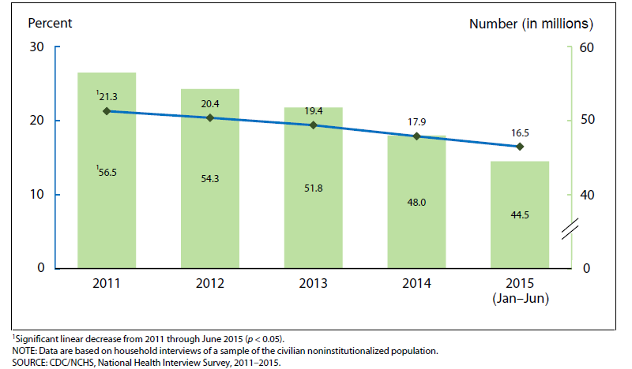
Invest in You
Health
  Insurmountable health care bills can result in poor credit history, bankruptcy, reduced income to allocate for retirement
  Health care events are the leading cause of personal bankruptcies
Rutgers School of Environmental and Biological Sciences
Notes:
Body is like a well-oiled machine. (Lifehack)
Give it high quality fuel. Make healthy food choices
Don’t push it too hard. Rest and relax often. Don’t overload your system.
Get regular and necessary maintenance. Go to the doctor when sick.
Polish the exterior? Haircuts. Clothes that make you feel confident.
Exercise gives you confidence to take on the day because of how you look and feel
Benefits: improved energy levels, less time lost to illness, improved health and Body, reduce chances of chronic Illness later in life, increased mental energy, boosted body image
Do something daily to invest in health

Slide 12


Invest in You
Good health choices regarding exercise, diet and insurance add to your financial well-being
Play 1:04 to 3:00

Slide 13

Invest in You
Why exercise?
Studies reveal exercise tends to:
Decrease the length of the common cold by 2 days
Increase memory, brain function
Okay, but how much exercise?
As little as 15 minutes of “vigorous” exercise 5 days a week
Walking for 30 minutes 5 days a week
Some combination of the two
People who exercise tend to be happier
More energy!
Rutgers School of Environmental and Biological Sciences
Notes:
Body is like a well-oiled machine. (Lifehack)
Give it high quality fuel. Make healthy food choices
Don’t push it too hard. Rest and relax often. Don’t overload your system.
Get regular and necessary maintenance. Go to the doctor when sick.
Polish the exterior? Haircuts. Clothes that make you feel confident.
Exercise gives you confidence to take on the day because of how you look and feel
Benefits: improved energy levels, less time lost to illness, improved health and Body, reduce chances of chronic Illness later in life, increased mental energy, boosted body image
Do something daily to invest in health

Slide 14
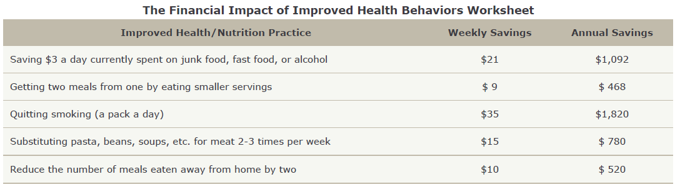
Invest in You
  Health
  Spending on unhealthy habits impacts availability of income for other purposes
  Take control and ensure spending matches all your priorities
Rutgers School of Environmental and Biological Sciences
Notes:
Body is like a well-oiled machine. (Lifehack)
Give it high quality fuel. Make healthy food choices
Don’t push it too hard. Rest and relax often. Don’t overload your system.
Get regular and necessary maintenance. Go to the doctor when sick.
Polish the exterior? Haircuts. Clothes that make you feel confident.
Exercise gives you confidence to take on the day because of how you look and feel
Benefits: improved energy levels, less time lost to illness, improved health and Body, reduce chances of chronic Illness later in life, increased mental energy, boosted body image
Do something daily to invest in health

Slide 15
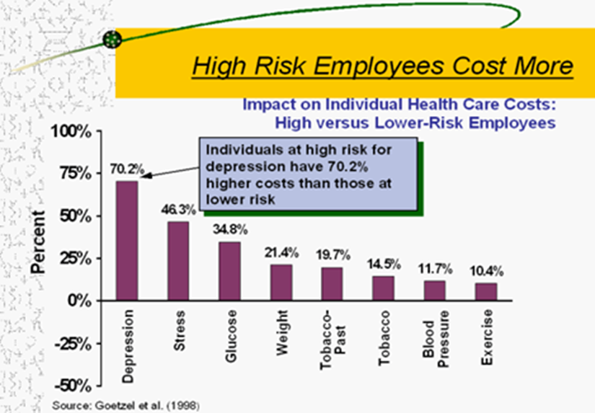
Invest in You
All things in moderation
Good habits are the key to a life well lived (exercise for 20-30 minutes, 3-4 days a week creates lasting benefits)
Reduce your health care outlays and improve your ability to succeed at your job

Slide 16
Health
Invest in You
Protect your good health by making smart choices in key areas:
  Exercise – Be active often to increase your mental - as well as physical - well-being.
  Food choices - Give your body high quality fuel by choosing healthy foods and limiting your sugar intake.
  Food portion size – How much you eat is as important as what you eat
  Health insurance – it’s important because it gives you access to regular checkups and maintenance to keep you in good health, and also protects your wealth and financial stability in the event you need medical care.

Slide 17
Invest in You
Research shows that only a small percentage of the variation in people’s happiness can be explained by differences in their circumstances but more so by thoughts and behaviors.
(Mayo Clinic)
'True happiness is to enjoy the present, without anxious dependence upon the future’
Seneca (@40 A.D)
Notes:
Nurture Mind (Life hack)
- Allows you to have more to give now and in the future, more knowledge, more compassion, more ideas,
- Expand Your Mind (Life Hack)Read, explore culture, Keep your mind active (word games – even words with friends, board games, using brain to perform simple calculations

Slide 18
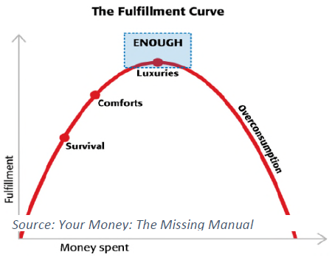
Invest in You
Contentment is relevant for well-being and financial well-being, because learning to spend less requires being content with what you have. More spending does often lead to more personal fulfilment up to a point. But spending too much can have a negative impact on quality of life. Studies show that salary above $75,000 does not lead to much higher levels of satisfaction
Notes:
Nurture Mind (Life hack)
- Allows you to have more to give now and in the future, more knowledge, more compassion, more ideas,
- Expand Your Mind (Life Hack)Read, explore culture, Keep your mind active (word games – even words with friends, board games, using brain to perform simple calculations

Slide 19
Invest in You - Contentment
  According to the CDC, well-being integrates mental and physical health and decreased risk of disease, illness and injury, better immune functioning and increased longevity are all associated with higher levels of well-being.
  The CDC also notes that individuals with high levels of well-being are more productive at work and more likely to contribute to their communities.
VIRTUOUS CYCLE
Financial Well-Being
Energy/Success at Work
Health
Contentment
Notes:
Body is like a well-oiled machine. (Lifehack)
Give it high quality fuel. Make healthy food choices
Don’t push it too hard. Rest and relax often. Don’t overload your system.
Get regular and necessary maintenance. Go to the doctor when sick.
Polish the exterior? Haircuts. Clothes that make you feel confident.
Exercise gives you confidence to take on the day because of how you look and feel
Benefits: improved energy levels, less time lost to illness, improved health and Body, reduce chances of chronic Illness later in life, increased mental energy, boosted body image
Do something daily to invest in health

Slide 20

Invest in You
CDC studies mention positive benefits to your life from physical and mental health!
Play 1:26 until 2:52

Slide 21
Invest in You
Key drivers of contentment include:
Devoting time to family and friends
Appreciating what you have
Maintaining an optimistic outlook
Feeling a sense of purpose
Living in the moment
Activities such as prayer and meditation are shown to create greater peace of mind
https://www.mindful.org/category/meditation/mindfulness-practice/– Tips to get you started on meditation.
Notes:
Nurture Mind (Life hack)
- Allows you to have more to give now and in the future, more knowledge, more compassion, more ideas,
- Expand Your Mind (Life Hack)Read, explore culture, Keep your mind active (word games – even words with friends, board games, using brain to perform simple calculations

Slide 22
Invest in You
Suggestions for building contentment:
Meditation or Prayer (20 minutes per day, lowers stress)
Plan for what you want – A bright future won’t just happen; you have to work toward it, set goals
Cultivate social outlets, networks build stronger positive outcomes
Find a healthy way to unwind from work
  Travel – Every year go somewhere you have never been
  Vacation time – Average American wastes 6 days/year
  Take up or continue a hobby
  Volunteer in area you are passionate about
  Learn something new, online or in person
  Creative pursuits – write, paint, pottery, build
  Think outside the box

Slide 23
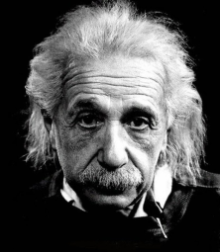
Invest for You - Compounding
“Compound interest is the eighth wonder of the world. He who understands it, earns it ... he who doesn't ... pays it.”
Albert Einstein

Slide 24
Invest for You - Compounding
Interest on interest on interest on interest…etc..
You work hard for your money so let market do the same for you!
Principal produces interest, which gets added and becomes the new principal
Leave it alone (be patient) and let the magic happen!
Interest
Principal
Year One Two Three Four

Slide 25
Invest for You
Keys to compounding
Let dividends and interest re-invest
Fees eat into your results (i.e. 7.5% average return so 75 bp fee is 10% drag)
Taxes matter so put less efficient assets in non-taxable accounts
Start early with whatever you can do, increase automatically
Be long term focused, only invest after emergency fund is in place
https://cfainstitute.org/learning/investor/tools/Pages/index.aspx - CFA Institute developed this library of articles and multimedia resources to educate investors on how to make informed decision

Slide 26
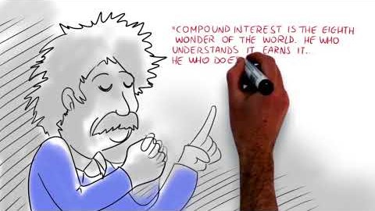
Invest for You - Compounding
Play 2:05 to 3:10
Gives a detailed visual example of how compounding works

Slide 27
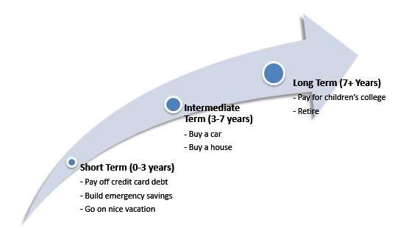
Match your Investment time frame and goals
Invest for You

Slide 28

Invest for You – Asset Types
Play :38 to 3:08
Gives a detailed visual example of different asset types

Slide 29
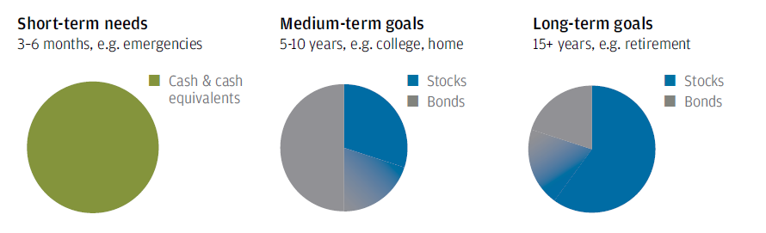
Invest for You
  Source: JP Morgan Guide to Retirement 2016

Slide 30
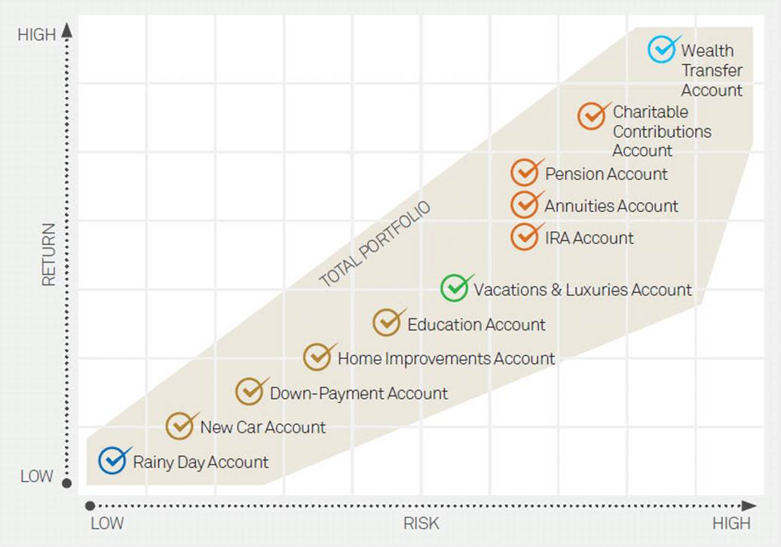
Invest for You
Rome wasn’t built in a day, work across risk and return spectrum
Live and learn from others, about their journey
Sharing plans and goals make them more achievable, real

Slide 31
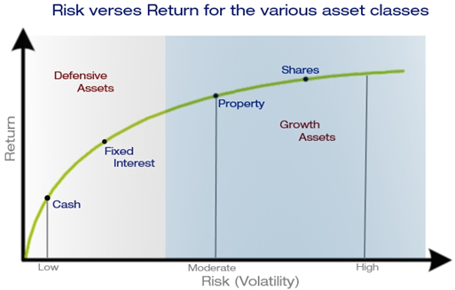
Invest for You
Growth assets and Defensive assets combine to achieve results
Active versus passive, lower fees a good predictor of returns
Investment versus Trading, media focuses on dramatic while you move ahead
Short term versus Long term (tax rate for short term much > long term rate)

Slide 32
Invest for You
Twenty Five Year Return (%)
March, 1992 to March, 2017
Investors hurt themselves with too much cash (i.e. women, millennials)
Bias to trade at the wrong time, have courage when others are fearful
Plan to check in on a disciplined schedule, ‘watched pot never boils”
A tree grows slowly but over long time, you can see the differences

Slide 33
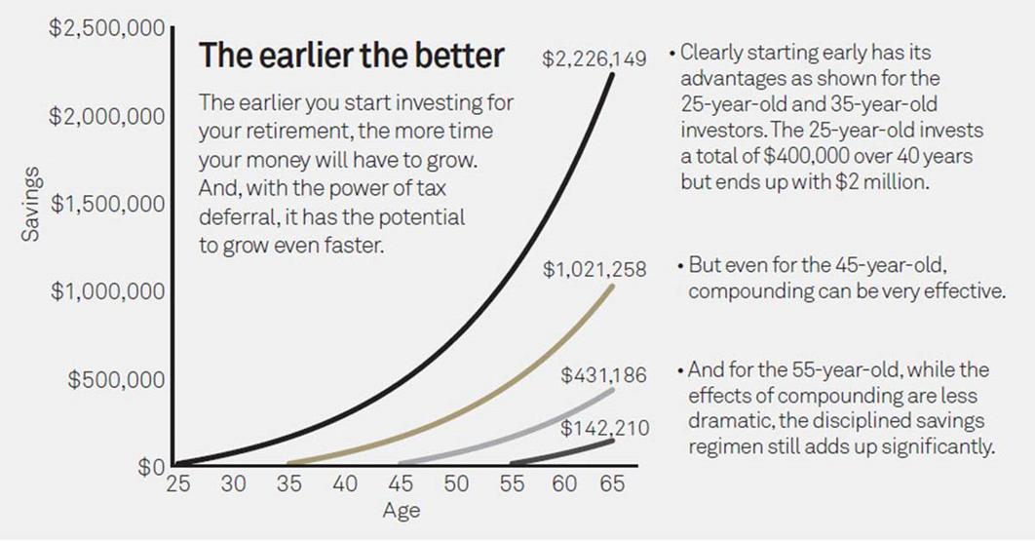
Invest for You – Retirement
Get ahead of the game by starting to play
Create a better tomorrow by starting today

Slide 34

Invest for You – Retirement
Play from 1:20 to 2:50
Women are more likely to have lower average wages, disruptions for children and parent care, longer lives and lower expected returns.
Retirement shortfalls can be lessened by good habits!

Slide 35
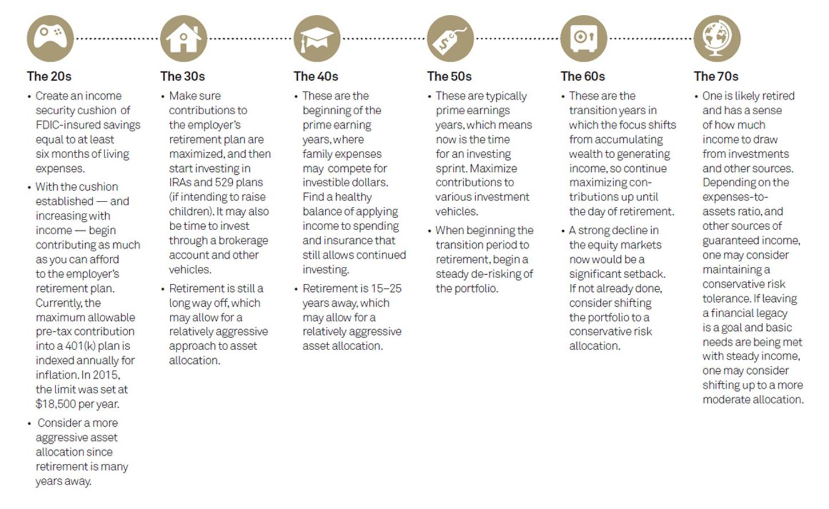
Invest for You
Understand where you are in the lifecycle and enjoy it
Each stage has its challenges and your plans will change
Always keep your head when others are losing theirs, perspective matters

Slide 36
Invest for You
SUMMARY
Start early, let the miracle of compounding work as hard as you do
Develop and follow your plan, update as needed
Diversify between defensive and growth assets to smooth the ride
Invest systematically and automatically (i.e. payroll deduction, auto transfers)
Think long term versus short term (marathon not a sprint)
Take advantage of 401k match, otherwise you are declining a raise!
https://investor.gov/ – Brought to you by The SEC’s Office of Investor Education and Advocacy, Investor.gov is your online resource to help you invest wisely and avoid fraud

Slide 37
Thanks to all our sponsors and volunteers for making this possible
Thanks to CFA Atlanta for support and inspiration as we move forward
Thanks to the CFA Institute for support and educational material
Check out our whole series of videos on YouTube
Follow ASFIP Foundation on LinkedIn, FB, Insta & Twitter
Online: CFAAtlanta.org/Foundation
Email: Foundation@CFAAtlanta.org

