Slide 1


ASFIP Foundation is a non-profit organization (501c 3), located in Atlanta. The Foundation was established as community outreach effort from the CFA Society Atlanta (an Atlanta CFA organization since 1960 with over 1600 members). ASFIP Foundation promotes financial literacy in the Atlanta community where CFA members work.

Slide 2
Invest in You
Manage Risks
Financial
Well-being
Live with Less
Invest for You
Our logo is made up of four “corner” pieces (or principles) which we like to think of as pieces of a frame
Our foundation tries to bring these principles to the community for improved financial well-being
We are helping individuals establish themselves with a plan for long term financial well-being

Slide 3
Live with Less
Live with Less
Budgeting
Pay Yourself First
Spending
Notes:
Learning to live with less is key to gaining financial security – we like to break living with less down to three components: Budgeting, Pay Yourself First, and Spending.
These three components work together to help you learn how to live with less.

Slide 4
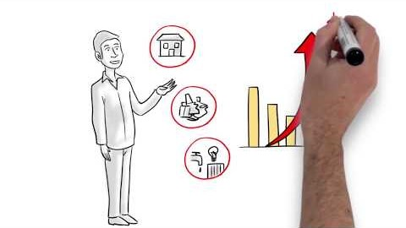
Live with Less – Budget
Play :50 through 3:00 for an example of doing a budget
Notes:
The first step of creating a budget is to WRITE it out
Writing your budget down makes it 60% more likely that you will actually follow your budget
Sharing your budget is even better – sharing a budget with a friend or family member gives you an 80% higher chance of following your budget = creates accountability

Slide 5
Live with Less – Budget
What you make (Income)
What you pay yourself (Savings)
What you spend (Expenses)
Golden Rule: ALWAYS SPEND LESS THAN YOU MAKE!
Notes:
There are certain basic principles that can make living a financially fulfilling life more attainable – don’t get overwhelmed if anything seems to tough to tackle, focus on what seems manageable and go from there.
Budgeting is important – it takes some effort at first, but eventually it will become second nature.
You start with what you make, income → the next priority is you, your savings is what you pay yourself, next come your expenses → Putting savings before expenses emphasizes the importance of this component
The golden rule seems intuitive, but credit cards and other types of debt have proven to make this an easy rule to break for a shockingly large number of Americans.

Slide 6
Live with Less – Budget
Begin the process of a budget and share with a friend for higher chance of success
GOOD = Writing a budget makes it 60% more successful
BETTER = Sharing a budget with a friend gives you an 80% greater chance of succeeding
Notes:
The first step of creating a budget is to WRITE it out
Writing your budget down makes it 60% more likely that you will actually follow your budget
Sharing your budget is even better – sharing a budget with a friend or family member gives you an 80% higher chance of following your budget = creates accountability

Slide 7
Live with Less – Budget
Guidelines for Life:
Needs
50%
Housing (25% max.)
Utilities
Wants
30%
New Shoes
Entertainment
Savings
20%
Retirement
Car and/or home fund
Food
Transportation
Dining out
Cable
Education (current and future)
Debt elimination (current and future)
Insurance
Notes:
You have to determine the most effective way to use your income; do you need a car or can you rely on public transportation.
Public transportation options should be a factor in your housing decision – it may be worth spending just a little more on housing if it means you can put off having a car for a while and save by not having to spend your income on a car payment, insurance, maintenance, and gas.
Our recommended breakdown is this: 50% for your Needs (i.e., what you need to live); 30% for your Wants (things that are nice to have, but not critical to your day-to-day life); and 20% for Savings.
Here are some examples of what falls in these categories, but you should customize your budget to fit your life.

Slide 8
Live with Less – Budget
Create Budget
Monthly Income | $3,000
Savings (Pay Yourself) | $600 (20%)
Needs | $1,500 (50%)
Wants | $900 (30%)
Guidelines for Life:
Savings = 20%, Needs = 50%, Wants = 30%
Notes:
The first step in living with less is creating a budget. A budget will act as your roadmap.
This breakdown should be used as a guideline – you should create a budget that works for you. If you can spend less on your needs, you can allocate more towards your savings.
Try not to exceed 30% on wants.
► Pay Yourself First: Set aside money for your savings goals to ensure you reach them

Slide 9
Live with Less – Budget
Create Future Plan
Monthly Income | $3,000
Savings (20%)
Retirement | $225
Education | $75
Reduce Debt | $150
Home/Car Fund | $150
How you plan future | $600
Guidelines for Life:
Savings = 20%, Needs = 50%, Wants = 30%
Notes:
Your future is important – saving for retirement is a very important element of planning for your future.
Social security was not meant to fully support Americans in later years, we can’t rely on that income.
The earlier you start investing in retirement plans, the more time your money has to grow.

Slide 10
Live with Less – Budget
Create Spending Plan – Needs
Monthly Income | $3,000
Needs (50%)
Housing/Rent | $750 (25% max)
Transportation | $200
Food | $350
Utilities | $200
What you live on | $1,500
Guidelines for Life:
Savings = 20%, Needs = 50%, Wants = 30%
Notes:
While 25% should be the max you spend on housing/rent, this is sometimes difficult to achieve. Though remember, the less you manage to spend on housing, the more you have to allocate to other areas (e.g., transportation is considering cost of unlimited MARTA pass, could spend more on car if can manage to spend less on housing)
Housing/Rent – tradeoffs, if you want to live in town you may need to live in a smaller space/have a roommate; if you choose to live further away, you may get more space but you may be further away from things that you enjoy (or you may really like living outside of the city and it can be a great way to save money)

Slide 11
Live with Less – Budget
Create Spending Plan – Wants
Monthly Income | $3,000
Wants (30%)
Entertainment | $350
Travel | $200
Cable/Phone | $150
Other | $200
How you rejuvenate | $900
Guidelines for Life:
Savings = 20%, Needs = 50%, Wants = 30%
Notes:
Your wants is where you can be the most creative with your budget. Is travel your priority? Try to spend less on entertainment, cable, or your phone so that you can save to take more trips.
It is important to allocate some of your budget towards “other” expense

Slide 12
Live with Less – Pay Yourself First
You pay yourself first by allocating 20% of your budget to savings!
Invest in yourself (e.g., skills and education) and your income will grow at an increasing rate
Pay yourself first so your priorities are being addressed
Spending controls are a key to reaching your goals, after your future is considered
Others may help you along the way but your plans should be to succeed on your own!
Notes:
Budgeting is how you create the plan, but your plan should start with YOU – that’s why you pay yourself first
Investing in you starts with paying yourself first – you set money aside not only for your future retirement, but to increase your value through investing in continuing education and other activities to enhance your professional value.
Investing in knowledge can pay off greatly. Not all continuing education costs money, you can find many online options that will allow you to develop skills for free. ToastMasters is an excellent way to enhance your public speaking skills, there are tons of chapters and membership is very affordable ($45 every 6 months).
To get certifications and degrees, you will likely need to spend money – but consider whether your employer has any programs you can take advantage of, e.g., tuition assistance.

Slide 13

Live with Less – Pay Yourself First
Play 2:00 through 3:05 to see an example of paying yourself first!
Notes:
The first step of creating a budget is to WRITE it out
Writing your budget down makes it 60% more likely that you will actually follow your budget
Sharing your budget is even better – sharing a budget with a friend or family member gives you an 80% higher chance of following your budget = creates accountability

Slide 14
Live with Less – Pay Yourself First
Payroll withdrawal or automatic transfers, the best discipline to success
Establish Emergency Fund - Potential cash flow concerns
  Save for unexpected accidents/ health issues
  Car repairs
  Lost or stolen items
Free Money
  Participate in Matching 401K to the maximum
  Use flexible spending accounts (i.e. HSA, Transportation) whenever possible
Develop a long term plan which reflects your values!
Notes:
Paying yourself first involves establishing an emergency fund – unexpected expenses are common and it is important to be prepared.
The rule of thumb is to try and have enough in your emergency fund to cover three months of your NEEDS (that is, basic living expenses). While three months of living expenses is a lot, keep in mind that it is a target and the key is to start early and set aside as much as possible until you reach that goal.
Building savings takes time, so try to have a long-term perspective when you think about your savings. While small contributions may not seem like much at the time, they will eventually start to add up.

Slide 15
Live with Less – Spending
Determine what is important to you and prioritize/determine tradeoffs
  Expense of owning a home versus traveling
  Eating out versus owning a car
  The incremental impact of $100 monthly savings on major items (car, rent, etc.)
  Buying new car versus used, UBER versus buying a car, public transportation
Notes:
After you have created your budget and spent sufficient time ensuring you pay yourself first, take a look at your spending
Start figuring out where you can make some cuts, this involves deciding what is important to you.
Think about whether you really need a new car or whether you could save money by relying on ride sharing services like Uber or Lyft for special trips and public transit for day-to-day transportation.
Students only have to pay $68 for unlimited monthly MARTA passes – that is likely less than you would spend on gas in a month
If you love living in town, then maybe consider how you can cut down in other areas to account for the generally higher cost of living (foregoing a car may be a good option if you live near a grocery store and can rely on public transportation)
Consider whether you really need a new phone or if you can use that money to do something that may be more rewarding – technology is advancing at an increasing rate and the newest phone will likely not be that new after 1 year

Slide 16
Live with Less – Spending
Determine what is important to you and prioritize/ determine tradeoffs
  Want a Starbucks latte and muffin, vs coffee and cereal
  Mass transit versus owning a car
  Nicer phone or taking a trip
  Live alone or with room mates, or at home
  Go to school nights versus full time
  Obtain a professional designation (CFA) versus a graduate degree (MBA)
Notes:
After you have created your budget and spent sufficient time ensuring you pay yourself first, take a look at your spending
Start figuring out where you can make some cuts, this involves deciding what is important to you.
Think about whether you really need a new car or whether you could save money by relying on ride sharing services like Uber or Lyft for special trips and public transit for day-to-day transportation.
Students only have to pay $68 for unlimited monthly MARTA passes – that is likely less than you would spend on gas in a month
If you love living in town, then maybe consider how you can cut down in other areas to account for the generally higher cost of living (foregoing a car may be a good option if you live near a grocery store and can rely on public transportation)
Consider whether you really need a new phone or if you can use that money to do something that may be more rewarding – technology is advancing at an increasing rate and the newest phone will likely not be that new after 1 year

Slide 17
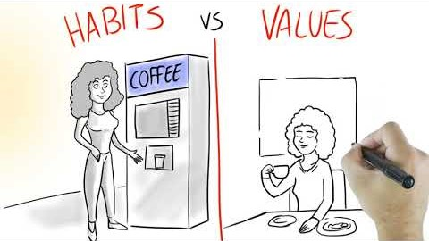
Live with Less – Spending
Play from 1:02 through 3:15 to get tips on controlling your spending!
Notes:
The first step of creating a budget is to WRITE it out
Writing your budget down makes it 60% more likely that you will actually follow your budget
Sharing your budget is even better – sharing a budget with a friend or family member gives you an 80% higher chance of following your budget = creates accountability

Slide 18
Live with Less – Spending
Adjust: Monitor Outcomes and Analyze Variances
Review monthly income and expenses against budget at a set time each month. Ask yourself these questions:
  Are the variances one time or ongoing?
  Are they controllable?
  Was your budget unrealistic?
  What led to the decision to spend more than budgeted?
Notes:
Reviewing and adjusting your spending is where your budget really comes to life. You have to ensure you are staying in line with what you established in your budget and make adjustments if you are not. If you are successful in sticking to your budget, consider increasing the amount you pay yourself first the next time you get a raise, bonus, or other income.
Change budget based on life events
Lost job – lower income, see if you can cut down on your Wants to avoid having to Pay Yourself less
Promotion – more money, more travel, more boarding for pets
Tax refund or bonus – put it towards your savings to give yourself a boost
Change expectations based on real life issues
Had major repairs due to a car accident that you paid out of pocket – staycation versus vacation
Take stock of what expenses are habits versus values (stopping every morning for coffee versus making coffee at home)
Moved home to take care of sick parent – contribute to food budget but use rent savings for condo down payment

Slide 19
Live with Less – Spending
Adjust: Monitor Outcomes and Analyze Variances
Spending needs to match your priorities - Pay in cash for a month
  Establish envelopes for each bill, pay biggest bills and your needs first
  Every reach into your pocket will cause you to evaluate the decision
  Credit cards make spending easy, avoid making impulse purchases
  See how small items add up when you use cash!
Notes:
Reviewing and adjusting your spending is where your budget really comes to life. You have to ensure you are staying in line with what you established in your budget and make adjustments if you are not. If you are successful in sticking to your budget, consider increasing the amount you pay yourself first the next time you get a raise, bonus, or other income.
Change budget based on life events
Lost job – lower income, see if you can cut down on your Wants to avoid having to Pay Yourself less
Promotion – more money, more travel, more boarding for pets
Tax refund or bonus – put it towards your savings to give yourself a boost
Change expectations based on real life issues
Had major repairs due to a car accident that you paid out of pocket – staycation versus vacation
Take stock of what expenses are habits versus values (stopping every morning for coffee versus making coffee at home)
Moved home to take care of sick parent – contribute to food budget but use rent savings for condo down payment

Slide 20
Live with Less – Tips
Avoid bulk discount stores
Make breakfast at home, bring your lunch
Make credit the exception, not the rule
Tools: apps can be useful, but beware of fees & understand what personal information you are giving away
It is easy to spend more each month when using apps and not keeping track of actual spending
Notes:
Avoid bulk discount stores
Buy more than you need, overconsume
Waste is higher so benefit goes away
Make breakfast at home, bring your lunch
Important to have energy in morning, start out right
Control your calories and your portions while also helping your budget
Shop with a plan at beginning of the week, stick to the discipline
Make credit the exception, not the rule. Using credit is necessary to build a good credit score, but be conscious with your use. You don’t have credit card debt if you pay your balance in full every month.
Avoid quick decisions, they are usually the worst.
Understand sale process, items have conversion time (e.g., cars sell for cheaper at year end since carmakers and dealerships try to sell vehicles from the outgoing model year)
Sleep on decisions over $100, the same item will be there in the morning
Credit for emergencies, avoid store credit cards (the discounts are negated by high interest rates and overspending)
Pay credit card bill in full every month, avoids high interest charges
Apps – there are certain apps that will automate savings and monitor your spending. Some are free and some cost money. There are a lot of free banking options where you can manage your own savings and avoid potential fees.

Slide 21
Manage Risk
Manage Risk
Avoid Fraud
Emergency Fund
Credit
Notes:
Learning to live with less is key to gaining financial security – we like to break living with less down to three components: Budgeting, Pay Yourself First, and Spending.
These three components work together to help you learn how to live with less.

Slide 22
Manage Risks – Avoid Fraud

Slide 23
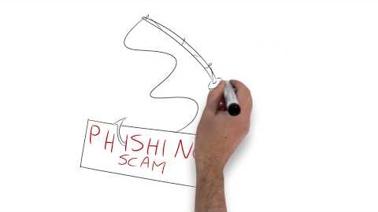
Manage Risk – Fraud
Play :45 through 3:15 for tips on Avoiding Fraud
Notes:
The first step of creating a budget is to WRITE it out
Writing your budget down makes it 60% more likely that you will actually follow your budget
Sharing your budget is even better – sharing a budget with a friend or family member gives you an 80% higher chance of following your budget = creates accountability

Slide 24
Manage Risks
Why should you be concerned about fraud?
  Online fraud is rising and so is the size of the damage
  Chips in credit cards have limited unlawful use but this switched the location of crimes to the internet
  If a thief steals your identity and begins racking up debt, it could take months, or years, to reverse the damage – better to protect yourself from it happening in the first place

Slide 25
Manage Risks
You expose yourself to fraud every time you:
  Give out your Social Security number
  Fail to check your bank account on a regular basis
  Enter payment information on unverified websites
  Click on links in an email from someone you don’t know
  Fail to freeze and monitor your credit reports
    http://clark.com/personal-finance-credit/credit-freeze-and-thaw-guide/

Slide 26
Manage Risks
May to July 2017, 143 million American consumers whose sensitive personal information was exposed in a data breach at Equifax, one of the nation’s three major credit reporting agencies.
What Can I Do?
You can get free copies of your credit report from the three major credit bureaus at www.annualcreditreport.com. Review your credit reports carefully, and make sure your personal information and accounts are correct.
Consider placing a security freeze or lock on your credit report. You can place a security freeze on your credit reports with the three major credit bureaus, Equifax, Experian, and TransUnion.
You can place a fraud alert on your credit reports with the three major credit bureaus. To place a fraud alert on your Equifax credit report, visit their Fraud Alert page. They will automatically contact the other two credit bureaus.

Slide 27
Manage Risk
Emergency Fund: What is it?
  Money set aside for use in the event of a personal financial dilemma, such as:
    Job loss
    Car repair
    Medical emergency (#1 cause of bankruptcy)
    Home repairs
  Currently 45% of the population don’t have $400 for an emergency and 60% don’t have $1000

Slide 28
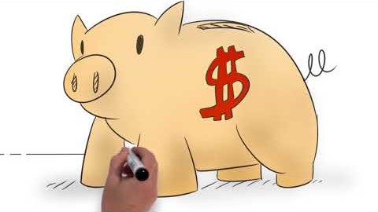
Manage Risk – Emergency Fund
Play :37 through 2:45 for details on why an emergency fund is important and how to set it up
Notes:
The first step of creating a budget is to WRITE it out
Writing your budget down makes it 60% more likely that you will actually follow your budget
Sharing your budget is even better – sharing a budget with a friend or family member gives you an 80% higher chance of following your budget = creates accountability

Slide 29
Manage Risk
Emergency Fund: Why do you need it? Among, may other reasons:
  Provides flexibility in job search, so you don’t have to take the first opportunity that arises, which can have a huge impact on your future earnings power and future financial
  Unexpected health expenses are number one cause of bankruptcies!
  Provides contentment and peace of mind (decreases stress levels)

Slide 30
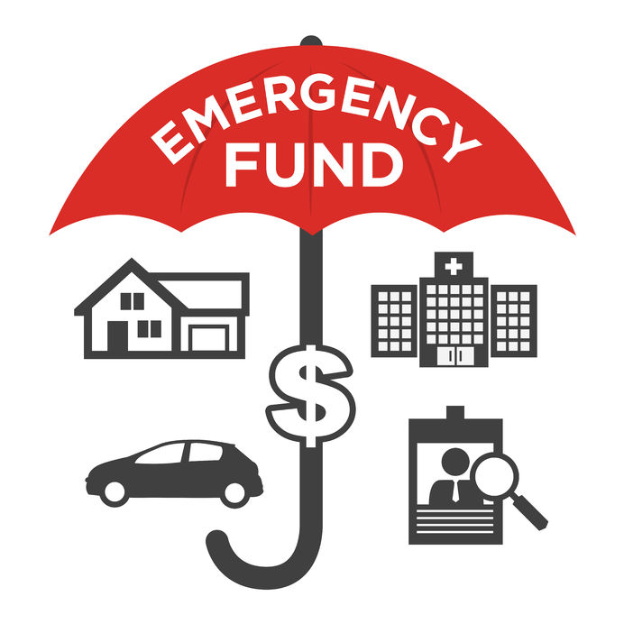
Manage Risk
Summary
    You will be far better prepared for those unexpected life events when you have an emergency fund to fall back on.
    Set it up at another online bank and forget about it
    Any money is better than none!(GET STARTED)

Slide 31
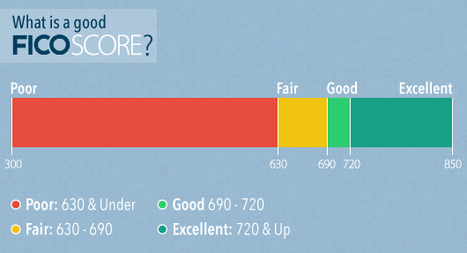
Manage Risk Credit and Debt
Credit Score = FICO score
  FICO does predictive analytics for three rating agencies
  Prepare data for ratings firms TransUnion, Experian and Equifax
  Scores range from 300 to 850 with higher being better!
  All aspects of financial wellbeing work together to produce good results

Slide 32
Manage Risk – Credit and Debt
Credit Score Components
  Manage your score like you do any grading system
  Attack the larger sections
  Automate payments
  Better scores leads to better rates on cars, insurance and homes!
  Understand it is your responsibility

Slide 33
Manage Risk
Payment History = 35%
  Most critical section, pay on time
  Ratings range from 1 – paid on time to 9 – in collections
  Automate payments whenever possible, ensures on-time payments, and declutters your life
  It takes time to get late or missed payments off so prevention is the key
  Pay off higher rate cards first
https://www.takechargeamerica.org/ This non profit works to restructure debt and move towards financial wellbeing

Slide 34
Manage Risk
Amount of Debt = 30%
  Score based on Revolving Utilization (i.e. All card limits = $2000 and using $500 would give you utilization of 25%)
  Get the number down as low as possible, guideline is always below 30%
  Ask to increase your limit so that the score improves
  Length of History = 15%
  Only way to build a history is be patient, take your time
  History improves with each loan paid off (car loans, student debt)
  Attack your debts in order of highest interest rate to lowest first, while ensuring minimum payments can be satisfied
    Credit cards typically have a higher interest rate than student debt.
  Automate some payments and use extra at end of month to accelerate

Slide 35
Manage Risk
New Credit = 10%
  Paying off credit and ability to add new credit builds record
  Only add credit to satisfy goals and when you can easily cover it
  Credit Mix = 10%
  Mixes of installment and revolving debt
    Revolving = Credit cards; Installment = Student Loans, Auto Loans, etc.
  Strong installment debt history will make future debt have lower rates and better terms!

Slide 36
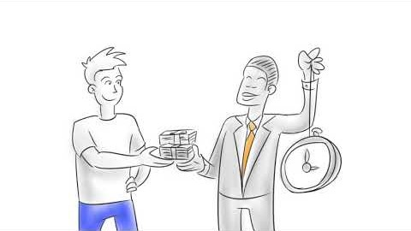
Manage Risk – Credit
Play :45 through 2:45 for tips on how credit scores can be improved!
Notes:
The first step of creating a budget is to WRITE it out
Writing your budget down makes it 60% more likely that you will actually follow your budget
Sharing your budget is even better – sharing a budget with a friend or family member gives you an 80% higher chance of following your budget = creates accountability

Slide 37
Manage Risk
Debt-to-Income Ratio
  Key component of your credit health
  Includes housing, auto, student loans, and credit card
  43% is a key guideline for your debt to income ratio. As a portion of your income try to keep to the following:
  Housing 28% max; lower is better
  Car loans 10% max; look at various commuting options
  Credit Cards 5%; with goal of paying 100% every month
https://www.credit.com/debt/debt-to-income-ratio/ Consumer Financial Protection Bureau has a wealth of free resources on their website

Slide 38
Manage Risk
Summary
    Credit and debt should be utilized carefully
    Rule regarding debt for college:
      Total debt less than Expected Starting Salary
    Put yourself in position to succeed by managing your FICO score
    Automate payments below some level ($150) to simplify your life and strengthen your scores, and secure your financial future!
https://www.consumer.ftc.gov/articles/0150-coping-debt The Federal Trade Commission webpage shares tips on debt management

Slide 39

Invest in You
  The effort you put into consistently investing in yourself plays a large role in determining the quality of your life now and in the future.
Areas of Investment
  Education – Human capital has historically shown good return when skills or education are achieved
  Health – Improved lifestyle results in numerous benefits beyond the obvious physical advantages
  Contentment – The state of being satisfied with what you have will meaningfully impact quality of life, regardless of financial status

Slide 40
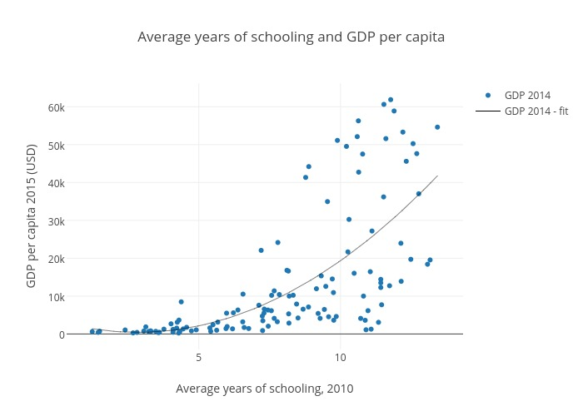
Invest in You
  Human capital was a term which came out of the Nobel Prize winning research of Gary Becker in 1964.
What does it mean for you?
  Capital is something an individual gets and can apply throughout their life
  Many industries (i.e. investment/software) the main capital goes up and down the elevators every day and they could go across the street if not cared for
  US – 30% college graduates versus ex US = 6%, continual learning will lead to higher incomes and cause greater prosperity so, “the more you learn, the more you earn!”.

Slide 41
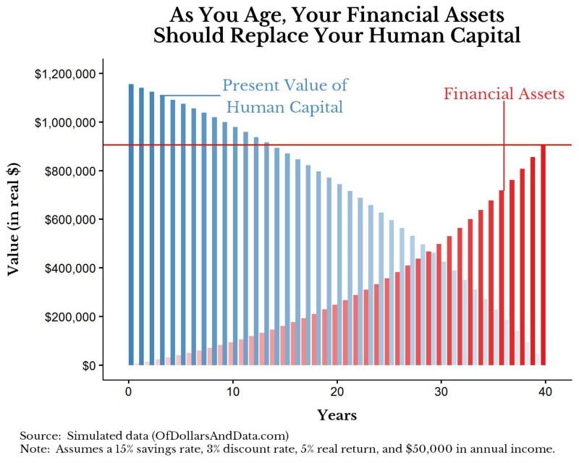
Invest in You
Most of your financial value is already contained within yourself, waiting to be unlocked over time.

Slide 42
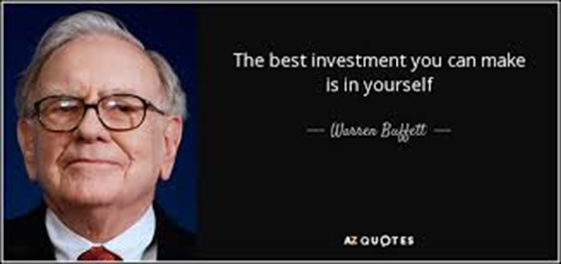
Invest in You
Investment in Education has been shown to yield innumerable financial, professional and personal benefits
“Education is not a bucket to be filled rather it is a fire to keep burning. “
William Butler Yeats

Slide 43
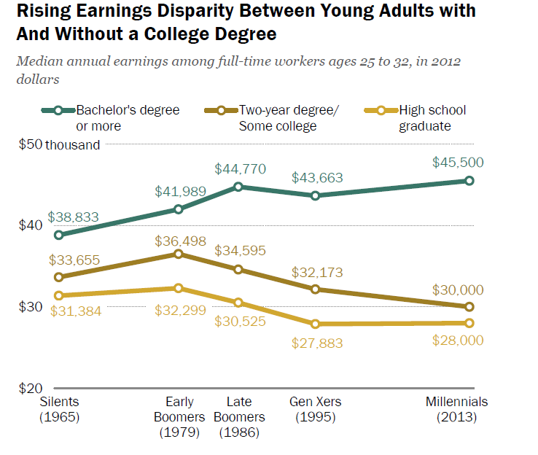
Invest in You
  Education
  Earnings disparity between education levels continues to widen

Slide 44

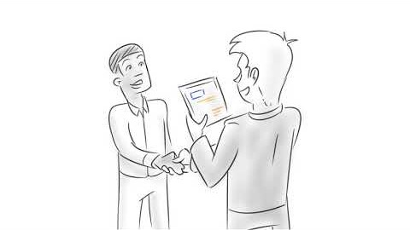
Highlight the benefits to college completion and to lifelong learning
Play :47 to 1:30

Slide 45

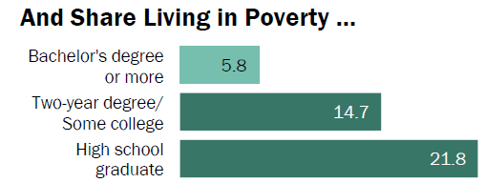
Invest in You
  Education
  Disparity among Millennials living in poverty based on education level is meaningful

Slide 46
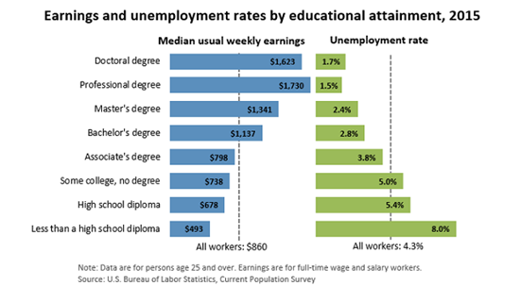
Invest in You
As educational attainment increases, so does the median weekly earnings
The stability of the earnings also improves as the unemployment rate goes down significantly
Attainment of Bachelor’s degree seems to be where above average results are achieved

Slide 47
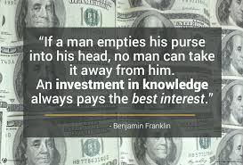
Invest in You
While much of the research focuses on the benefits of formal, post-secondary education, there is a variety of ways to increase one’s level of education
  Advanced degrees
  Relevant certifications
  Workshops/Conferences
  Books, articles, publications, blogs, news
Notes:
Develop your skills, advance your education
Advanced degrees, relevant certifications, workshops, conferences, webinars, books, articles, white papers, publications, blogs, news
Learning a new skill can help develop passions and interests in life

Slide 48
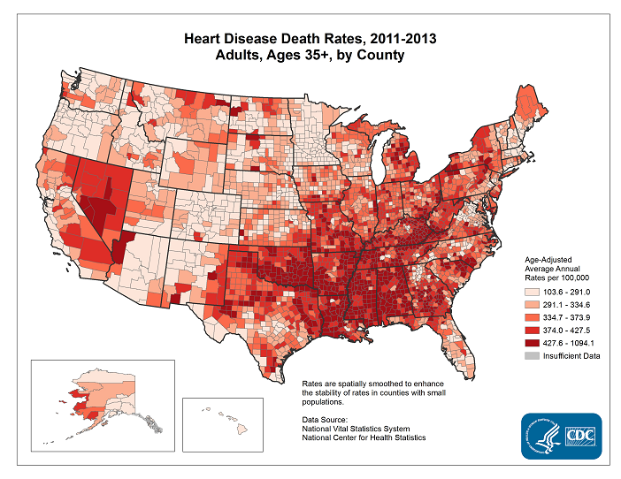
Invest in You – Health
Health
  A healthy lifestyle can reduce risk of heart disease and stroke increasing life expectancy
  Heart Disease is the leading cause of death in both men and women in the US. (1 in 4 deaths)
Notes:
Body is like a well-oiled machine. (Lifehack)
Give it high quality fuel. Make healthy food choices
Don’t push it too hard. Rest and relax often. Don’t overload your system.
Get regular and necessary maintenance. Go to the doctor when sick.
Polish the exterior? Haircuts. Clothes that make you feel confident.
Exercise gives you confidence to take on the day because of how you look and feel
Benefits: improved energy levels, less time lost to illness, improved health and Body, reduce chances of chronic Illness later in life, increased mental energy, boosted body image
Do something daily to invest in health

Slide 49
Invest in You – Health
Benefits of investing in personal Health encompass various aspects of well-being including physical, psychological as well as financial
Body is like a well-oiled machine. (Lifehack)
Give it high quality fuel. Make healthy food choices
Don’t push it too hard. Rest and relax often.
Don’t overload your system.
Get regular and necessary maintenance. Go to the doctor when sick.
Polish the exterior? Haircuts. Clothes that make you feel confident
https://www.myfitnesspal.com/ - Apps for tracking calories and exercise
Notes:
Body is like a well-oiled machine. (Lifehack)
Give it high quality fuel. Make healthy food choices
Don’t push it too hard. Rest and relax often. Don’t overload your system.
Get regular and necessary maintenance. Go to the doctor when sick.
Polish the exterior? Haircuts. Clothes that make you feel confident.
Exercise gives you confidence to take on the day because of how you look and feel
Benefits: improved energy levels, less time lost to illness, improved health and Body, reduce chances of chronic Illness later in life, increased mental energy, boosted body image
Do something daily to invest in health

Slide 50
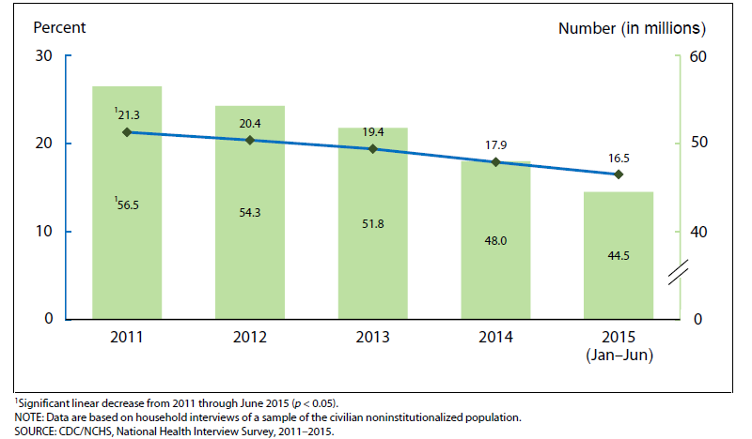
Invest in You
Health
  Insurmountable health care bills can result in poor credit history, bankruptcy, reduced income to allocate for retirement
  Health care events are the leading cause of personal bankruptcies
Rutgers School of Environmental and Biological Sciences
Notes:
Body is like a well-oiled machine. (Lifehack)
Give it high quality fuel. Make healthy food choices
Don’t push it too hard. Rest and relax often. Don’t overload your system.
Get regular and necessary maintenance. Go to the doctor when sick.
Polish the exterior? Haircuts. Clothes that make you feel confident.
Exercise gives you confidence to take on the day because of how you look and feel
Benefits: improved energy levels, less time lost to illness, improved health and Body, reduce chances of chronic Illness later in life, increased mental energy, boosted body image
Do something daily to invest in health

Slide 51


Invest in You
Good health choices regarding exercise, diet and insurance add to your financial well-being
Play 1:04 to 3:00

Slide 52

Invest in You
Why exercise?
Studies reveal exercise tends to:
Decrease the length of the common cold by 2 days
Increase memory, brain function
Okay, but how much exercise?
As little as 15 minutes of “vigorous” exercise 5 days a week
Walking for 30 minutes 5 days a week
Some combination of the two
People who exercise tend to be happier
More energy!
Rutgers School of Environmental and Biological Sciences
Notes:
Body is like a well-oiled machine. (Lifehack)
Give it high quality fuel. Make healthy food choices
Don’t push it too hard. Rest and relax often. Don’t overload your system.
Get regular and necessary maintenance. Go to the doctor when sick.
Polish the exterior? Haircuts. Clothes that make you feel confident.
Exercise gives you confidence to take on the day because of how you look and feel
Benefits: improved energy levels, less time lost to illness, improved health and Body, reduce chances of chronic Illness later in life, increased mental energy, boosted body image
Do something daily to invest in health

Slide 53
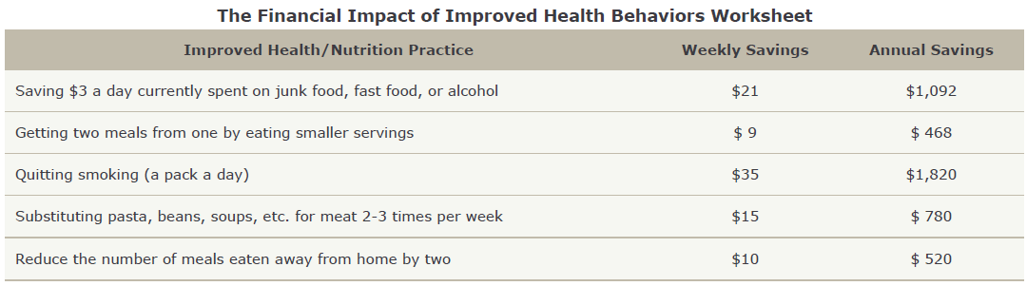
Invest in You
  Health
  Spending on unhealthy habits impacts availability of income for other purposes
  Take control and ensure spending matches all your priorities
Rutgers School of Environmental and Biological Sciences
Notes:
Body is like a well-oiled machine. (Lifehack)
Give it high quality fuel. Make healthy food choices
Don’t push it too hard. Rest and relax often. Don’t overload your system.
Get regular and necessary maintenance. Go to the doctor when sick.
Polish the exterior? Haircuts. Clothes that make you feel confident.
Exercise gives you confidence to take on the day because of how you look and feel
Benefits: improved energy levels, less time lost to illness, improved health and Body, reduce chances of chronic Illness later in life, increased mental energy, boosted body image
Do something daily to invest in health

Slide 54
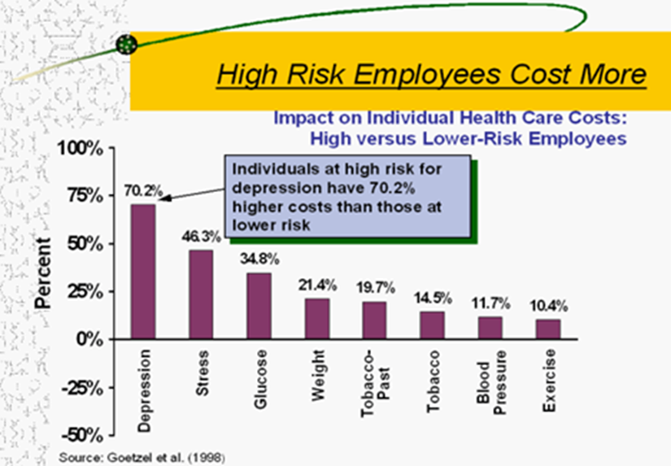
Invest in You
All things in moderation
Good habits are the key to a life well lived (exercise for 20-30 minutes, 3-4 days a week creates lasting benefits)
Reduce your health care outlays and improve your ability to succeed at your job

Slide 55
Health
Invest in You
Protect your good health by making smart choices in key areas:
  Exercise – Be active often to increase your mental - as well as physical - well-being.
  Food choices - Give your body high quality fuel by choosing healthy foods and limiting your sugar intake.
  Food portion size – How much you eat is as important as what you eat
  Health insurance – it’s important because it gives you access to regular checkups and maintenance to keep you in good health, and also protects your wealth and financial stability in the event you need medical care.

Slide 56
Invest in You
Research shows that only a small percentage of the variation in people’s happiness can be explained by differences in their circumstances but more so by thoughts and behaviors.
(Mayo Clinic)
'True happiness is to enjoy the present, without anxious dependence upon the future’
Seneca (@40 A.D)
Notes:
Nurture Mind (Life hack)
- Allows you to have more to give now and in the future, more knowledge, more compassion, more ideas,
- Expand Your Mind (Life Hack)Read, explore culture, Keep your mind active (word games – even words with friends, board games, using brain to perform simple calculations

Slide 57
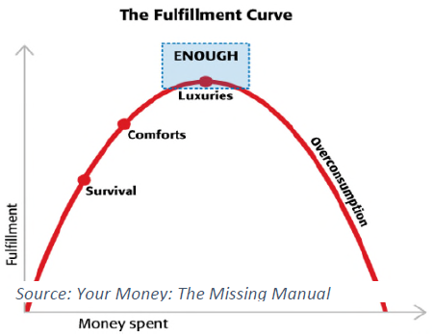
Invest in You
Contentment is relevant for well-being and financial well-being, because learning to spend less requires being content with what you have. More spending does often lead to more personal fulfilment up to a point. But spending too much can have a negative impact on quality of life. Studies show that salary above $75,000 does not lead to much higher levels of satisfaction
Notes:
Nurture Mind (Life hack)
- Allows you to have more to give now and in the future, more knowledge, more compassion, more ideas,
- Expand Your Mind (Life Hack)Read, explore culture, Keep your mind active (word games – even words with friends, board games, using brain to perform simple calculations

Slide 58
Invest in You - Contentment
  According to the CDC, well-being integrates mental and physical health and decreased risk of disease, illness and injury, better immune functioning and increased longevity are all associated with higher levels of well-being.
  The CDC also notes that individuals with high levels of well-being are more productive at work and more likely to contribute to their communities.
VIRTUOUS CYCLE
Financial Well-Being
Energy/Success at Work
Health
Contentment
Notes:
Body is like a well-oiled machine. (Lifehack)
Give it high quality fuel. Make healthy food choices
Don’t push it too hard. Rest and relax often. Don’t overload your system.
Get regular and necessary maintenance. Go to the doctor when sick.
Polish the exterior? Haircuts. Clothes that make you feel confident.
Exercise gives you confidence to take on the day because of how you look and feel
Benefits: improved energy levels, less time lost to illness, improved health and Body, reduce chances of chronic Illness later in life, increased mental energy, boosted body image
Do something daily to invest in health

Slide 59

Invest in You
CDC studies mention positive benefits to your life from physical and mental health!
Play 1:26 until 2:52

Slide 60
Invest in You
Key drivers of contentment include:
Devoting time to family and friends
Appreciating what you have
Maintaining an optimistic outlook
Feeling a sense of purpose
Living in the moment
Activities such as prayer and meditation are shown to create greater peace of mind
https://www.mindful.org/category/meditation/mindfulness-practice/– Tips to get you started on meditation.
Notes:
Nurture Mind (Life hack)
- Allows you to have more to give now and in the future, more knowledge, more compassion, more ideas,
- Expand Your Mind (Life Hack)Read, explore culture, Keep your mind active (word games – even words with friends, board games, using brain to perform simple calculations

Slide 61
Invest in You
Suggestions for building contentment:
Meditation or Prayer (20 minutes per day, lowers stress)
Plan for what you want – A bright future won’t just happen; you have to work toward it, set goals
Cultivate social outlets, networks build stronger positive outcomes
Find a healthy way to unwind from work
  Travel – Every year go somewhere you have never been
  Vacation time – Average American wastes 6 days/year
  Take up or continue a hobby
  Volunteer in area you are passionate about
  Learn something new, online or in person
  Creative pursuits – write, paint, pottery, build
  Think outside the box

Slide 62

Invest for You - Compounding
“Compound interest is the eighth wonder of the world. He who understands it, earns it ... he who doesn't ... pays it.”
Albert Einstein

Slide 63
Invest for You - Compounding
Interest on interest on interest on interest…etc..
You work hard for your money so let market do the same for you!
Principal produces interest, which gets added and becomes the new principal
Leave it alone (be patient) and let the magic happen!
Interest
Principal
Year One Two Three Four

Slide 64
Invest for You
Keys to compounding
Let dividends and interest re-invest
Fees eat into your results (i.e. 7.5% average return so 75 bp fee is 10% drag)
Taxes matter so put less efficient assets in non-taxable accounts
Start early with whatever you can do, increase automatically
Be long term focused, only invest after emergency fund is in place
https://cfainstitute.org/learning/investor/tools/Pages/index.aspx - CFA Institute developed this library of articles and multimedia resources to educate investors on how to make informed decision

Slide 65
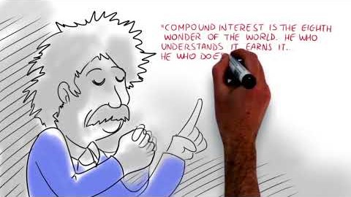
Invest for You - Compounding
Play 2:05 to 3:10
Gives a detailed visual example of how compounding works

Slide 66
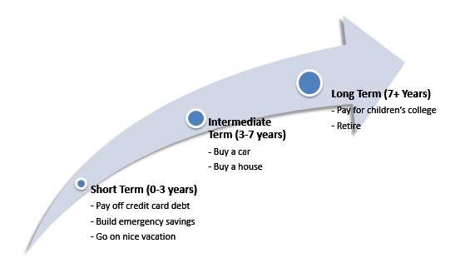
Match your Investment time frame and goals
Invest for You

Slide 67
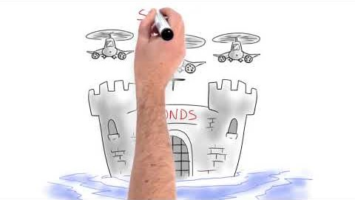
Invest for You – Asset Types
Play :38 to 3:08
Gives a detailed visual example of different asset types

Slide 68
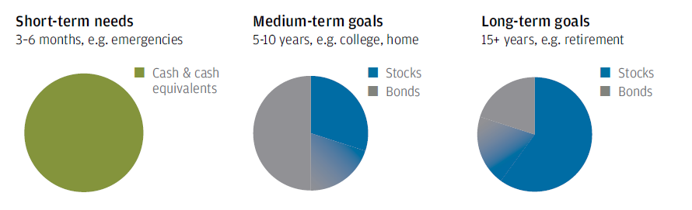
Invest for You
  Source: JP Morgan Guide to Retirement 2016

Slide 69
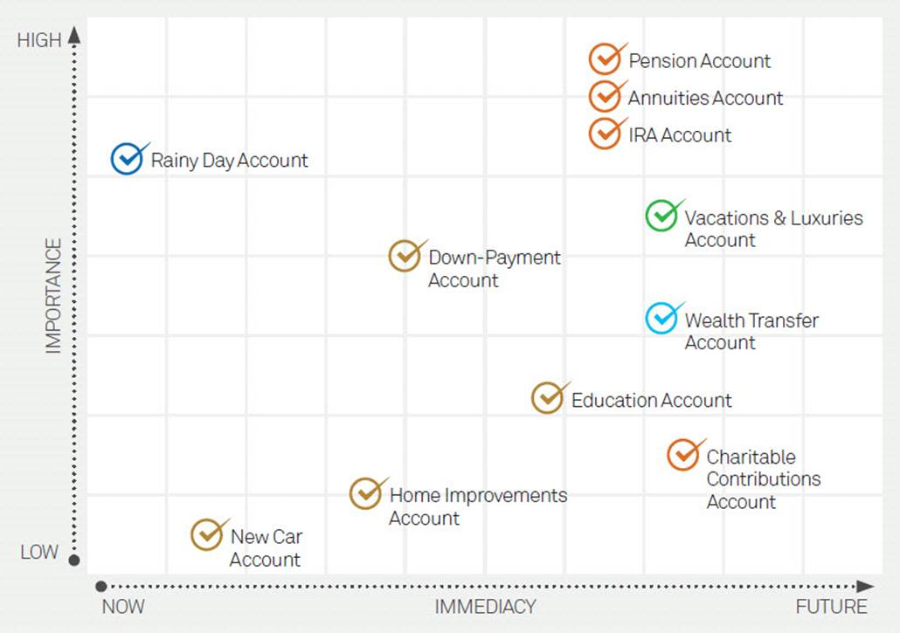
Invest for You
Plan for the life that you want
Goals have an importance and a time frame, satisfy both
Accept tradeoffs and move on, you are responsible

Slide 70
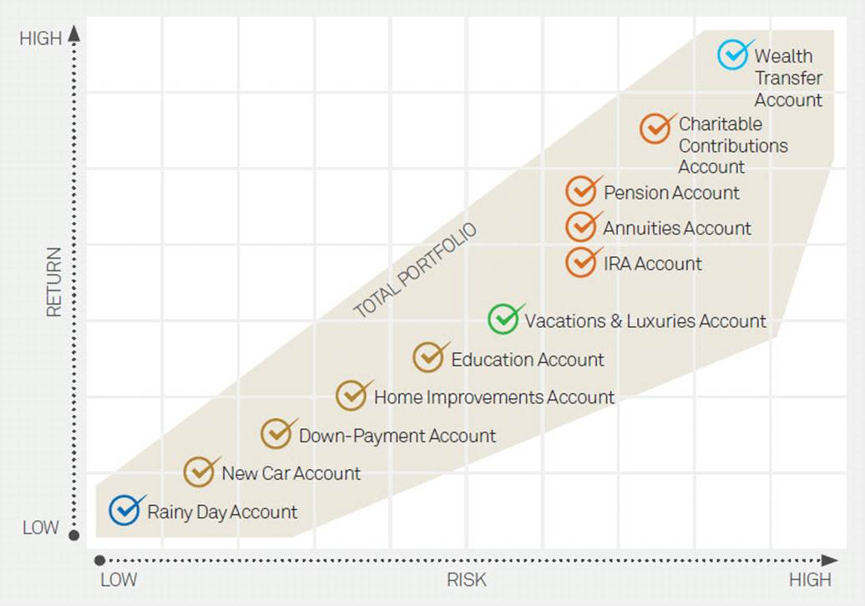
Invest for You
Rome wasn’t built in a day, work across risk and return spectrum
Live and learn from others, about their journey
Sharing plans and goals make them more achievable, real

Slide 71
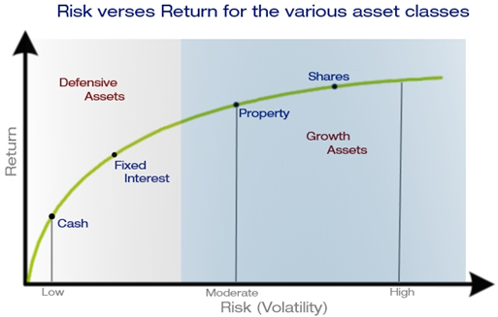
Invest for You
Growth assets and Defensive assets combine to achieve results
Active versus passive, lower fees a good predictor of returns
Investment versus Trading, media focuses on dramatic while you move ahead
Short term versus Long term (tax rate for short term much > long term rate)

Slide 72
Invest for You
Twenty Five Year Return (%)
March, 1992 to March, 2017
Investors hurt themselves with too much cash (i.e. women, millennials)
Bias to trade at the wrong time, have courage when others are fearful
Plan to check in on a disciplined schedule, ‘watched pot never boils”
A tree grows slowly but over long time, you can see the differences

Slide 73
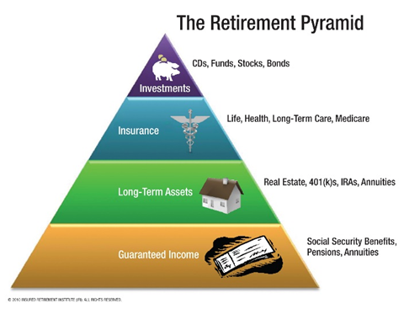
Invest for You
Retirement expenses one of our biggest expenses
Plan for living longer and greater health (Inflation matters)

Slide 74
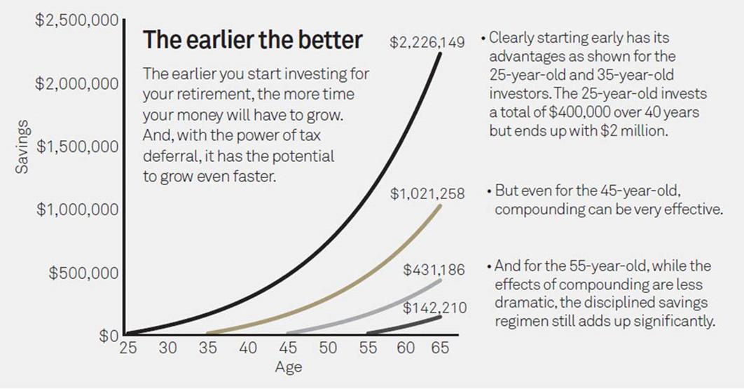
Invest for You – Retirement
Get ahead of the game by starting to play
Create a better tomorrow by starting today

Slide 75
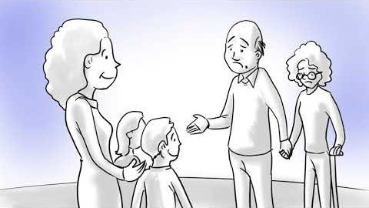
Invest for You – Retirement
Play from 1:20 to 2:50
Women are more likely to have lower average wages, disruptions for children and parent care, longer lives and lower expected returns.
Retirement shortfalls can be lessened by good habits!

Slide 76
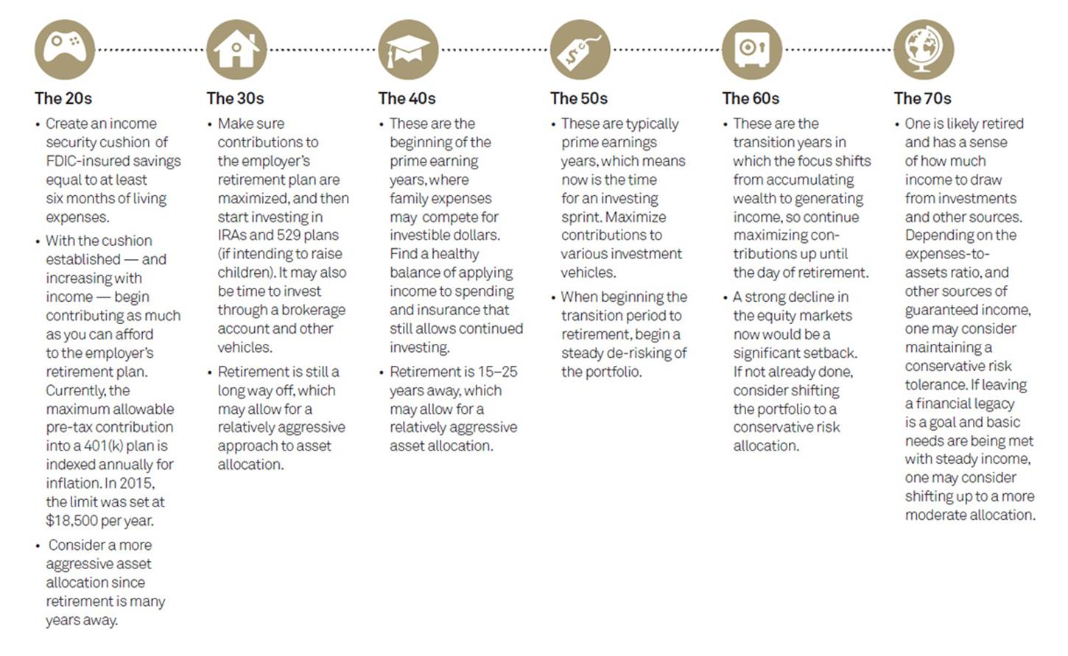
Invest for You
Understand where you are in the lifecycle and enjoy it
Each stage has its challenges and your plans will change
Always keep your head when others are losing theirs, perspective matters

Slide 77
Invest for You
SUMMARY
Start early, let the miracle of compounding work as hard as you do
Develop and follow your plan, update as needed
Diversify between defensive and growth assets to smooth the ride
Invest systematically and automatically (i.e. payroll deduction, auto transfers)
Think long term versus short term (marathon not a sprint)
Take advantage of 401k match, otherwise you are declining a raise!
https://investor.gov/ – Brought to you by The SEC’s Office of Investor Education and Advocacy, Investor.gov is your online resource to help you invest wisely and avoid fraud

Slide 78







Thanks to all our sponsors and volunteers for making this possible
Thanks to CFA Atlanta for support and inspiration as we move forward
Thanks to the CFA Institute for support and educational materials
Follow ASFIP Foundation on
Online: CFAAtlanta.org/Foundation
Email: Foundation@CFAAtlanta.org

